Slide 1
Team presentation-1 NTCIR-15 Dialogue Evaluation Task
組員 : 黃彥鈞、黃顗亘、鄭宇雅、廖容毅

Slide 2
Outlines
Competition Introduction
Data Description
Evaluation
Approaches and Progress

Slide 3
Competition Introduction(I)
Dialogue Quality (DQ)
Given a customer-helpdesk dialogue, return an estimated distribution of dialogue quality ratings for the entire dialogue.
NTCIR-15 DialEval-1
Nugget Detection (ND)
Given a customer-helpdesk dialogue, return an estimated distribution of labels over nugget types (similar to dialogue acts) for each turn.
Data: Chinese and English
Noted that the dataset is provided by the University of Waseda, Japan

Slide 4


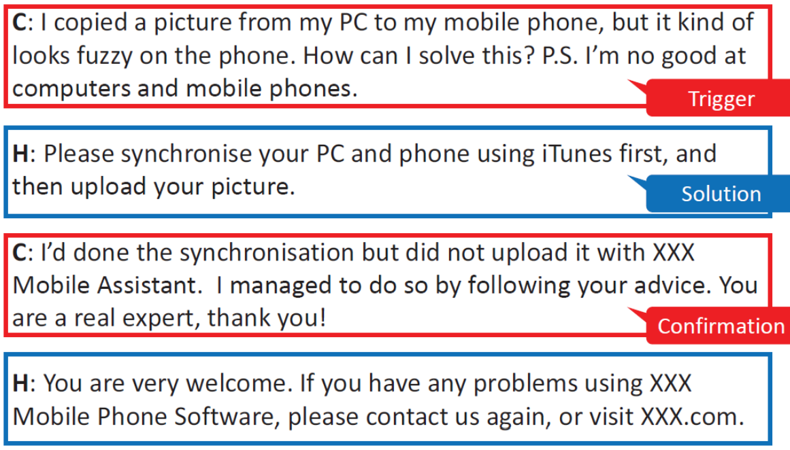
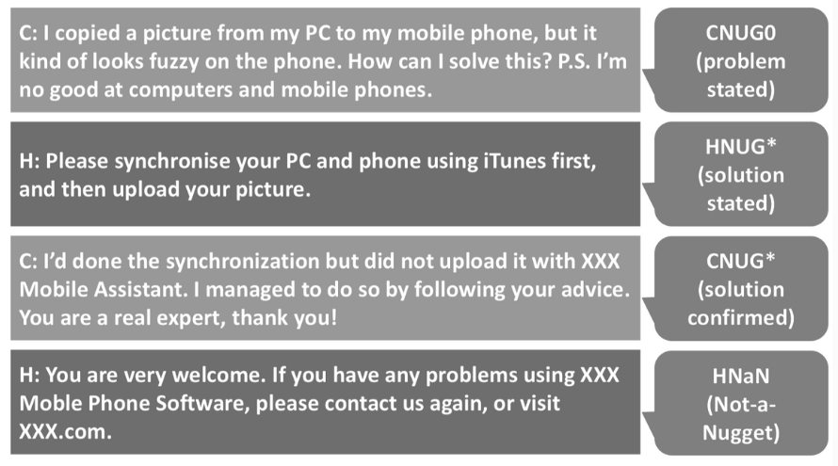
Competition Introduction(II)
19 Annotators

Slide 5
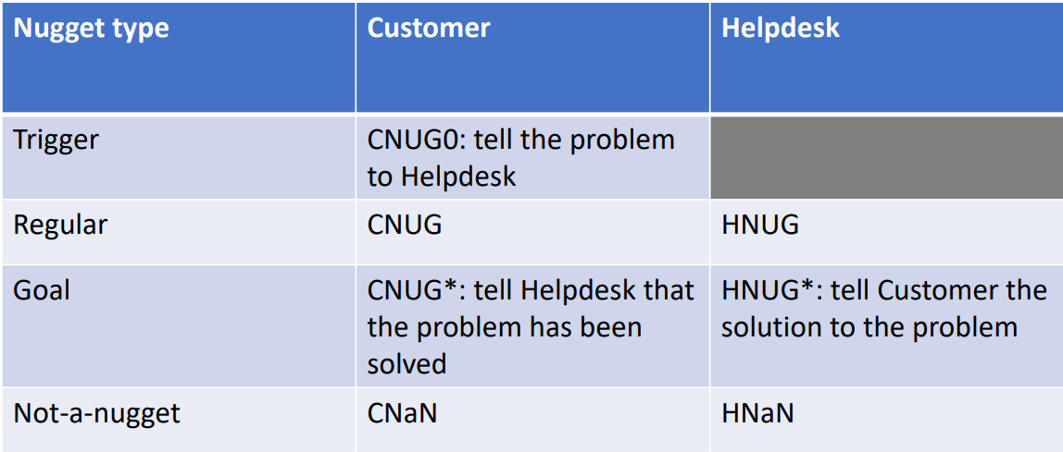
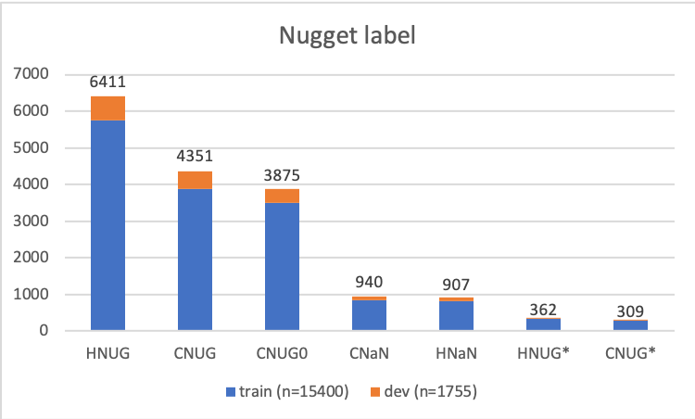
Data Description(I)
Nugget Labels
CNUG0 | Customer trigger
CNUG* | Customer goal
HNUG* | Helpdesk goal
CNUG | Customer regular nugget
HNUG | Helpdesk regular nugget
CNaN | Customer Not-a-Nugget
HNaN | Helpdesk Not-a-Nugget

Slide 6
Data Description(II)
Train
3700
Chinese dataset
4090
Dev
390
Crawled from Weibo.
Data
annotations
nugget
turns
id
Dial-quality
sender
utterances

Slide 7
Evaluation
During the data annotation, we noticed that annotators’ assessment of dialogues are highly subjective and are hard to consolidate them into one gold label. Thus, we proposed to preserve the diverse views in the annotations “as is” and leverage them at the step of evaluation measure calculation.
Instead of judging whether the estimated label is equal to the gold label, we compare the difference between the estimated distributions and the gold distributions calculated by 19 annotators’ annotations.
Nugget:
RNSS: Root Normalised Sum of Squared errors
JSD: Jensen-Shannon divergence

Slide 8
Approaches and Progress(I)
For preprocessing,
The main obstacle we are facing now is about the ambiguous evaluation method… So we are first accumulating the maximum nugget for each utterance (donated as max_nugget) that simplifying the multi-labels_multi_classification into an single-labels_multiple-classification issue.
19 Nuggets
Maximum the nugget
1 Nugget
For each utterance (sentence)

Slide 9
Approaches and Progress(II)
First, we decided not do any of optional preprocessing and just load the utterance as text dataset to see the outcome of the baseline ML(Top model and Bottom model) :
Secondly, we are aimed to generate the order for each utterance in each case, noted that each case has been tagged by case’s id. Although it is a simple way but it is very important.
First outcome
 | accuracy
BernoulliNB | 0.77
MultinomialNB | 0.68
SVC | 0.8
LogisticRegression | 0.8
RandomForest | 0.77
KNN | 0.34
DecisionTree | 0.7
xgboost | 0.77
CNN | 0.75
LSTM | 0.76
SVC
precision recall f1-score support
0 0.69 0.87 0.77 477
1 0.67 0.17 0.28 23
2 0.87 0.96 0.91 374
3 0.25 0.03 0.05 101
4 0.87 0.91 0.89 662
5 0.00 0.00 0.00 33
6 0.74 0.24 0.36 85
accuracy 0.80 1755
macro avg 0.58 0.45 0.47 1755
weighted avg 0.76 0.80 0.76 1755
KNN
precision recall f1-score support
0 0.37 0.51 0.43 477
1 0.21 0.13 0.16 23
2 0.83 0.05 0.10 374
3 0.05 0.15 0.07 101
4 0.84 0.41 0.55 662
5 0.33 0.03 0.06 33
6 0.10 0.52 0.17 85
accuracy 0.34 1755
macro avg 0.39 0.26 0.22 1755
weighted avg 0.61 0.34 0.36 1755

Slide 10


Approaches and Progress(III)
Case 1
Case 2
order
sender
utterance
max_nugget
1
Question statement
CNUG0
2
Solution_1
HNUG
Case 3
3
Confirmation
CNUG

Slide 11
Approaches and Progress(IV)

Slide 12
Approaches and Progress(V)
Second outcome

Slide 13
Approaches and Progress(VI)
Next steps :
Input the distribution for each nugget of each utterance directly to see how is the outcome.
Try to weight different max_nugget depends on each order of utterance.
Try sequence_based method to optimize the neural network method.

